Slide 1
Assemblies and Deployment

Slide 2
Contents
Understanding assemblies
Deploying private assemblies
Deploying shared assemblies
Understanding WinMD files
Demos folder:
Demos-A-Deployment

Slide 3
1. Understanding Assemblies
What is an assembly?
Assembly manifests
Creating a single-file assembly
Viewing full metadata
Creating a multi-file assembly
Viewing metadata for a multi-file assembly

Slide 4
What is an Assembly?
An 'assembly' is a Microsoft term to describe a set of one or more logically-related files
Each file in an assembly is known as a 'module'
Single-file assemblies
If you are using VS, you will always produce single-file assemblies
Each project produces a single .exe or .dll file
Multi-file assemblies
If you are using .NET Framework compilers from the command line, you can produce multi-file assemblies
Contain several modules, each of which can be developed in a different .NET language

Slide 5
Assembly Manifests
Every assembly has a manifest
Contains versioning and security information
In a single-file assembly…
The manifest is included as part of the assembly
In a multi-file assembly…
Only one module in the assembly holds the assembly manifest
This is the 'main module' in the assembly, and typically has a .exe or .dll extension
The manifest lists the other modules that make up the assembly
These modules have a .netmodule extension, by default

Slide 6

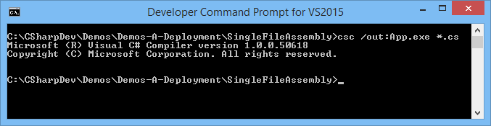
Creating a Single-File Assembly
To create a single-file assembly:
Compile one or more source files (same .NET language) into a single .exe or .dll assembly file
See the SingleFileAssembly demo folder
public class MyHelloClass
{
public static void SayHello()
{
Console.WriteLine("Hello!");
}
}
MyHelloClass.cs
public class MyByeClass
{
public static void SayBye()
{
Console.WriteLine("Bye!");
}
}
MyByeClass.cs
public class MyMainClass
{
public static void Main()
{
MyHelloClass.SayHello();
MyByeClass.SayBye();
}
} MyMainClass.cs

Slide 7
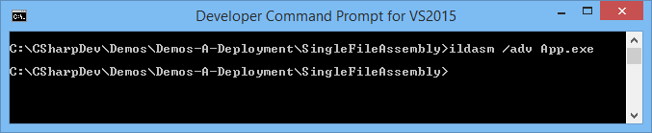
Viewing Full Metadata (1 of 4)
We've already seen how to use ildasm to view the MSIL for an assembly
Assemblies also contain metadata
Describes the types that are defined in the assembly
Also contains references to other types that our assembly uses, from other assemblies
To view full metadata for an assembly, use the /adv switch with ildasm:

Slide 8
Viewing Full Metadata (2 of 4)
In ildasm, select View | MetaInfo | Show!
.NET module metadata:
Assembly metadata:
ScopeName : SingleFileAssembly.exe -- Name of .NET module
MVID : {779CA42B-5FA0-40F6-A12F-C024B82F5734} -- Unique Module version ID
Assembly
-------------------------------------------
Token: 0x20000001 -- Unique token for item of metadata
Name : SingleFileAssembly -- Name of assembly
Public Key : -- Public key used to sign assembly
Major Version: 0x00000000 -- The Major Version, Minor Version,
Minor Version: 0x00000000 Build Number and Revision Number
Build Number: 0x00000000 define a 4-part version number
Revision Number: 0x00000000 for this assembly (see later)
Locale: <null> -- Allows for localization
…

Slide 9
Viewing Full Metadata (3 of 4)
Metadata about types defined in this assembly:
TypeDef #2 (02000003)
-------------------------------------------------------
TypDefName: MyHelloClass (02000003)
Flags : [Public] [AutoLayout] [Class] [AnsiClass] [BeforeFieldInit] (00100001)
Extends : 01000001 [TypeRef] System.Object
Method #1 (06000003)
-------------------------------------------------------
MethodName: SayHello (06000003)
Flags : [Public] [Static] [HideBySig] [ReuseSlot] (00000096)
RVA : 0x00002066
ImplFlags : [IL] [Managed] (00000000)
CallCnvntn: [DEFAULT]
ReturnType: Void
No arguments.
Method #2 (06000004)
-------------------------------------------------------
MethodName: .ctor (06000004)
Flags : [Public] [HideBySig] [ReuseSlot] [SpecialName] [RTSpecialName]
[.ctor] (00001886)
RVA : 0x00002074
ImplFlags : [IL] [Managed] (00000000)
CallCnvntn: [DEFAULT]
hasThis
ReturnType: Void
No arguments
...

Slide 10
Viewing Full Metadata (4 of 4)
Metadata about referenced assemblies and types:
AssemblyRef #1 (23000001)
-------------------------------------------------------
Token: 0x23000001
Public Key or Token: b7 7a 5c 56 19 34 e0 89
Name: mscorlib
Version: 4.0.0.0
Major Version: 0x00000004
Minor Version: 0x00000000
Build Number: 0x00000000
Revision Number: 0x00000000
Locale: <null>
Flags: [none] (00000000)
TypeRef #1 (01000001)
-------------------------------------------------------
Token: 0x01000001
ResolutionScope: 0x23000001
TypeRefName: System.Object
MemberRef #1 (0a000004)
-------------------------------------------------------
Member: (0a000004) .ctor:
CallCnvntn: [DEFAULT]
hasThis
ReturnType: Void
No arguments.
...

Slide 11
Creating a Multi-File Assembly (1 of 3)
Why create multi-file assemblies?
Enables you to mix-and-match .NET programming languages within the same assembly
Can reduce footprint and improve performance
Place logically-related types into the same module, so that they are loaded together by the CLR
Seldom-used types can be relegated to a separate module, to avoid being loaded unnecessarily
To define resource-only modules
E.g. images, music clips, XML documents, etc.
The .NET Framework SDK includes an assembly linker tool (AL.exe) to link non-MSIL modules into our assembly

Slide 12
Creating a Multi-File Assembly (2 of 3)
How to create a multi-file assembly:
Compile one or more source files (same .NET language) into a .netmodule module file
Repeat the previous step, to create all the other .netmodule modules that you need
Designate one module as the main module in the assembly
The main module will contain the assembly manifest, which lists all the other modules that are part of the assembly

Slide 13
Creating a Multi-File Assembly (3 of 3)
Example (MultiFileAssembly demo folder)
public class CS1 CS1.cs
{
public static void MA() {…}
}
public class CS2 CS2.cs
{
public static void MB() {…}
}
csc /target:module /out:MyCSharp.netmodule CS1.cs CS2.cs
Public Class VB1 VB1.vb
Public Shared Sub MC() …
End Sub
End Class
Public Class VB2 VB2.vb
Public Shared Sub MD() …
End Sub
End Class
vbc /target:module /out:MyVBNet.netmodule VB1.vb VB2.vb
public class MyMain MyMain.cs
{
public static void Main() {…}
}
csc /addmodule:MyCSharp.netmodule;MyVBNet.netmodule MyMain.cs

Slide 14
Viewing Metadata for a Multi-File Assembly
The main module in the assembly (MyMain.exe) houses the assembly manifest, which contains:
References to modules that are part of the assembly
Information about types defined in each module in the assembly
.module extern MyCSharp.netmodule
.module extern MyVBNet.netmodule
.class extern public CS1
{
.file MyCSharp.netmodule
.class 0x02000002
}
.class extern public CS2
{
.file MyCSharp.netmodule
.class 0x02000003
}
.class extern public VB1
{
.file MyVBNet.netmodule
.class 0x02000002
}
.class extern public VB2
{
.file MyVBNet.netmodule
.class 0x02000003
}

Slide 15
2. Deploying Private Assemblies
Creating applications with multiple assemblies
Deployment guidelines
Example: Deploying private assemblies
How the CLR locates private assemblies
Controlling private assembly deployment

Slide 16
Creating Apps with Multiple Assemblies
For simple applications, you can deploy the application as a single assembly
A single .exe/.dll file, with additional .netmodule files if necessary
For larger applications, you can split the functionality into separate assemblies
Group related functionality into the same assembly
So the CLR can load all related types, all at once
Create reusable assemblies
To simplify deployment of common code

Slide 17
Deployment Guidelines
Two ways to deploy multi-assembly applications…
Private assemblies
Use this approach if you have assemblies that are only used by a single application
Private assemblies are placed in the same folder (or sub-folder) as the main assembly
Enables you to achieve XCOPY deployment
Shared assemblies
Use this approach if you have assemblies that are used by several applications
Shared assemblies must be placed in a central location called the 'Global Assembly Cache' (GAC)
All assemblies in the GAC are strong-named (version number, etc.) to avoid conflicts when newer versions are installed in future

Slide 18
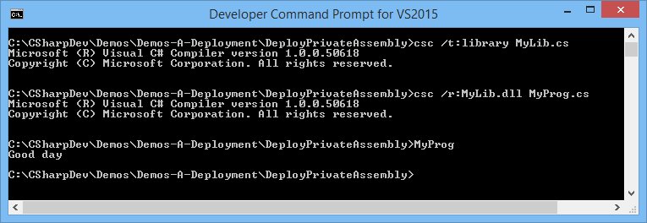
Example: Deploying Private Assemblies
This example uses a private assembly, MyLib.dll
See the DeployPrivateAssembly demo folder
public class MyLib MyLib.cs {
public static string GetMsg()
{
return (DateTime.Now.Hour < 12) ? "Good morning" : "Good day";
}
}
public class MyProg MyProg.cs
{
public static void Main()
{
Console.WriteLine("{0}", MyLib.GetMsg());
}
}

Slide 19
How the CLR Locates Private Assemblies
When you run a .NET application that references a private assembly (e.g. MyLib), the CLR probes the following locations to find the assembly:
MyLib.dll
MyLib\MyLib.dll
MyLib.exe
MyLib\MyLib.exe
If the CLR can't locate the assembly, a run-time exception occurs
1
2
3
4

Slide 20
Controlling Assembly Deployment (1 of 2)
If you want to control where private assemblies are deployed, you can provide an application (XML) configuration file as follows
The application configuration file has the same name as the application, with .config appended
See the ControlledDeployPrivateAssembly demo folder
<configuration> MyProg.exe.config
<runtime>
<assemblyBinding
xmlns="urn:schemas-microsoft-com:asm.v1">
<probing privatePath="MySubFolder1;MySubFolder2"/>
</assemblyBinding>
</runtime>
</configuration>

Slide 21
Controlling Assembly Deployment (2 of 2)
The CLR now tries to locate MyLib as follows:
MyLib.dll
MyLib\MyLib.dll
MySubFolder1\MyLib.dll
MySubFolder1\MyLib\MyLib.dll
MySubFolder2\MyLib.dll
MySubFolder2\MyLib\MyLib.dll
MyLib.exe
MyLib\MyLib.exe
MySubFolder1\MyLib.exe
MySubFolder1\MyLib\MyLib.exe
MySubFolder2\MyLib.exe
MySubFolder2\MyLib\MyLib.exe
1
2
3
4
5
6
7
8
9
10
11
12

Slide 22
3. Deploying Shared Assemblies
Shared assemblies: a recap
Creating a public key
Creating a shared assembly
Using the shared assembly
Deploying the shared assembly
Running the application

Slide 23
Shared Assemblies: A Recap
Shared assemblies…
Use this approach if you have assemblies that are used by several applications
Shared assemblies must be placed in a central location called the 'Global Assembly Cache' (GAC)
All assemblies in the GAC are strong-named (version number, etc.) to avoid conflicts when newer versions are installed in

Slide 24
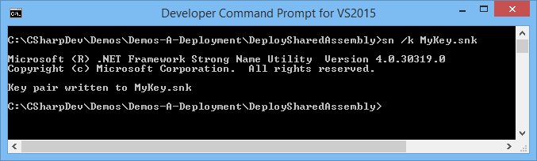
Creating a Public Key
Shared assemblies must be 'strong named'
They require a name, a version number, a public key, and (optionally) locale information
Prevents accidental name clashes between assemblies that happen to have the same filename ('DLL hell')
Therefore the first step is to create a public key, using sn.exe in the .NET Framework SDK

Slide 25
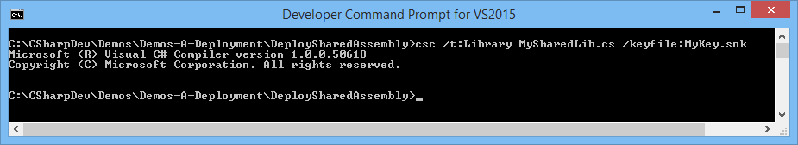
Creating a Shared Assembly
Next, write the code for the shared assembly
See the DeploySharedAssembly demo folder
When you build the assembly, use the /keyfile flag
public class MySharedLib MySharedLib.cs
{
public static string GetMsg()
{
return "This is a really useful function";
}
}

Slide 26
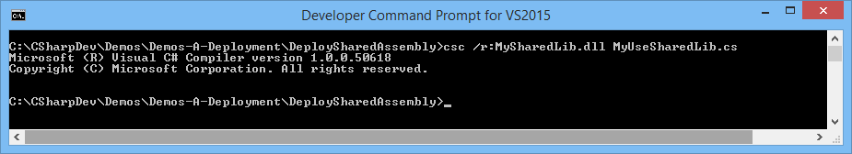
Using the Shared Assembly
Now write an application that makes use of the shared assembly
Compile the application as usual
The /r[eference] flag locates assemblies at compile time
public class MyUseSharedLib MyUseSharedLib.cs
{
public static void Main()
{
Console.WriteLine("{0}", MySharedLib.GetMsg());
}
}

Slide 27
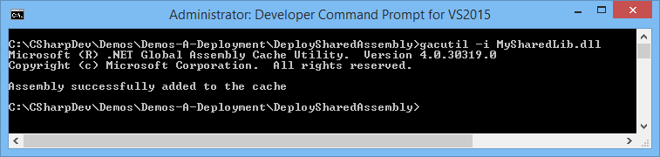
Deploying the Shared Assembly
Deploy the shared assembly into the Global Assembly Cache (GAC) on the target computer
Using the gacutil.exe tool
gacutil devises a specific, unique, subfolder for each assembly in the GAC
Based on assembly's name, version, PK, and locale info
Avoids the possibility of assemblies being overwritten

Slide 28
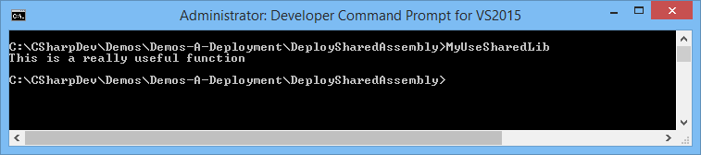
Running the Application
Run the application as usual
The app's metadata contains a reference to the shared assembly
The CLR looks in the GAC to locate an assembly with the same strong name, and then loads the assembly into CLR memory
What will happen if you install a new version of the shared assembly into the GAC in future?

Slide 29
4. Understanding WinMD Files
Overview of WinMD files
Using WinMD files
Under the covers

Slide 30
Overview of WinMD Files
The Windows Runtime (WinRT) in Windows 8 upwards provides a set of new APIs
Housed in Windows Metadata (WinMD) files
CLR 4.5 upwards, part of the .NET Framework in Windows 8 upwards, allows you to use the new APIs naturally from C# etc.
Just as though you're using any other class library

Slide 31
Using WinMD Files
To use the new WinMD APIs:
Add a reference to the WinMD file
Call the APIs just as with a standard managed API
Visual Studio automatically adds a reference to the built-in WinRT APIs to new Windows UI projects
So your app can simply begin using this new API set

Slide 32
Under the Covers
Under the covers, the CLR maps between file formats in regular managed assemblies and WinMD files
Application
CLR
Metadata
API
.NET Assembly
Metadata
Adapter
.winmd
file

Slide 33
Any Questions?

